Slide 1
Arrays
Simeon Angelov

Slide 2
Content
Arrays
Multidimensional arrays
Autoboxing and Unboxing
Facts about the quiz

Slide 3

Arrays
Fixed sized sequential collection of elements of same type
Creation of an array (one of the ways)
int[] numbers = new int[5];
Size of the array
Type of array

Slide 4
Arrays
Syntax of defining of arrays
Data_type[] refToArray; -> Integer[] months;
Data_type refToArray[]; -> Integer months[];
Syntax of creating of arrays:
Syntax | Example
Data_type[] refToArray = new Data_type[arraySize]; | Integer[] months = new Integer[12];
Data_type[] refToArray = {value0, value1, ..., valuek}; | Integer[] months = {1, 2, 3, 4, 5, 6 , 7, 8, 9, 10, 11, 12};
Data_type[] refToArray = new DataType[] {value0, value1, …}; | short [] args = new short[]{50, 50};
Data_type [] refToArray = … | short [] args = new short[4];
Data_type refToArra [] | short args [] = new short[5];

Slide 5
Array
String[] names = {"Giorgi", "Tamar", "Ketevan", "Manana", "Nikoloz"};
The elements are sequently allocated in the memory.
reference
names
names[0] | “Giorgi”
names[1] | “Tamar”
names[2] | “Ketevan”
names[3] | “Manana”
names[4] | “Nikoloz”
Element at Index 0 has value “Girogi”

Slide 6
Array
Arrays are objects
The length of the array is getting via length property
int[] names = new int[5];
int sizeOfNames = names.length;
The elements are ordered and each element has index, starting from 0
size of an array must be specified by an int value and not long or short
Throws ArrayIndexOutOfBoundsException if the arrays is accessed with an illegal index value
The size of the array cannot be negative – throws java.lang.NegativeArraySizeException at runtime

Slide 7
Array
Array is a reference type
Integer [] numbers = {1, 2, 3};
Integer [] numbers2 = numbers;
System.out.println(numbers.equals(numbers2)); // true as they are pointing same memory
toString() method prints type and hash code, not so much useful information
System.out.println(numbers); // [Ljava.lng.String;84395fhjfh]

Slide 8
Array
Declaration and instantiating of an array strictly must be of same type. Only auto upcasting is allowed
Integer[] I = new int[5]; //Compile Time Error : Auto-Boxing not allowed
int[] i = new Integer[10]; //Compile Time Error : Auto-UnBoxing not allowed
long[] l = new byte[10]; //Compile Time Error : Auto-widening not allowed
Object[] o = new String[10]; //No Compile Time Error : Auto-Upcasting is allowed, String[] is upcasted to Object[]

Slide 9
Array
The type of elements of an array must be compatible with type of the array object
Object[] o = new String[2];
o[0] = "java";
o[1] = 3; //No Compile time error, but you will get java.lang.ArrayStoreException at run time.

Slide 10
Array
Examples of correct and not correct initializations
int[] numbers = {1, 2, 3}; //This is the correct way
numbers = {1, 2, 3 , 4}; //Compile time error – it should be populated at the time of declaration
numbers = new int[]{1, 2, 3 }; //This is also correct way
int numbers [] = {1, 2, 3}; // OK

Slide 11
Array
While assigning one array reference variable to another, compiler checks only type of the array not the size.
int[] a = new int[10];
int[] b = new int[100];
double[] c = new double[20];
a = b; // array a and array b are same type
b = c; //Compile Time Error : can not convert from double[] to int[]

Slide 12
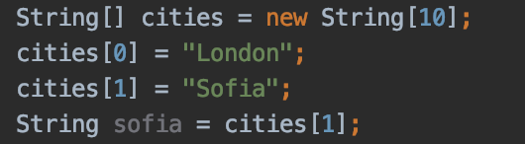
Array
Assigning a value to an element in an array:
refToArray[index] = newValue;
Accessing the value of an element of array:
Type_of_Data var = refToArray[index];

Slide 13
Array
Demo: javarrays_8
Exercise: exercises_java_arrays_8 -> ScannerNumbers & Student

Slide 14

Multidimensional arrays
Array of arrays
Each element of the array holding the reference of other array
Syntax
data_type[1st dimension][2nd dimension][]..[Nth dimension] array_name = new data_type[size1][size2]….[sizeN];
Example: int arr[][] = { {1, 2}, {1, 2, 3}, { 1 } };
arr[0][0] = 1;
arr[1][2] = 3;
int [] firstRow = arr[0];
1 | 2
arr
1 | 2 | 3
1

Slide 15
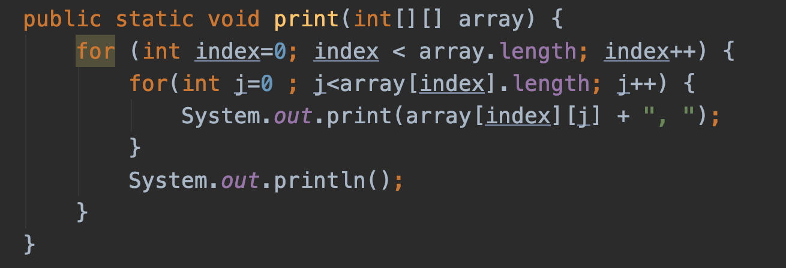
Multidimensional arrays
Usage of multidimension arrays

Slide 16
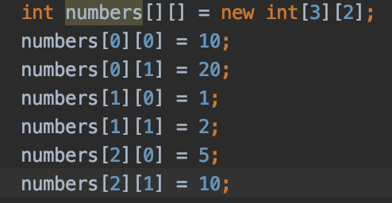
Multidimensional arrays
Example: int arr[][] = new int[3][2];
3 rows with 2 elements each

Slide 17
Multidimensional arrays
You must remember to specify the first dimension int[][] a = new int[2][]; -> valid
int[][] wrong = new int[][]; -> Not valid
int [] arr3 [] = new int[8][]; -> valid

Slide 18
Multidimensional arrays
A 3-dimensional array is an array of two – dimensional array
Declaration
data_type[][][] array_name = new data_type[x][y][z];
For example: int[][][] arr = new int[10][20][30];
Initialization
array_name[array_index][row_index][column_index] = value;
For example: arr[0][0][0] = 1;

Slide 19
Multidimensional arrays
Syntax
data_type[][][] array_name = {
{
{valueA1R1C1, valueA1R1C2, ....},
{valueA1R2C1, valueA1R2C2, ....}
},
{
{valueA2R1C1, valueA2R1C2, ....},
{valueA2R2C1, valueA2R2C2, ....}
}
};
For example: int[][][] arr = { {{1, 2}, {3, 4}}, {{5, 6}, {7, 8}} };

Slide 20

Multidimensional arrays
int[][][] arr = { {{1, 2}, {3, 4}}, {{5, 6}, {7, 8}} };
arr[0][0][0]=1
Arr[1][0][1]=?
1 | 2
3 | 4
5 | 6
7 | 8

Slide 21
Multidimesonal arrays
Demo javarrays_8
Exercise : javaarrays_8 -> ScannerStudents

Slide 22
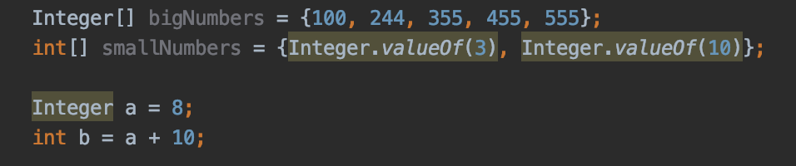
Autoboxing and Unboxing
Autoboxing
Converts a primitive type into it’s wrapper type (int to Integer, double to Double)
Like primitive types are boxed into their Object wrappers
Unboxing
Converts the wrapper class into primitive type

Slide 23
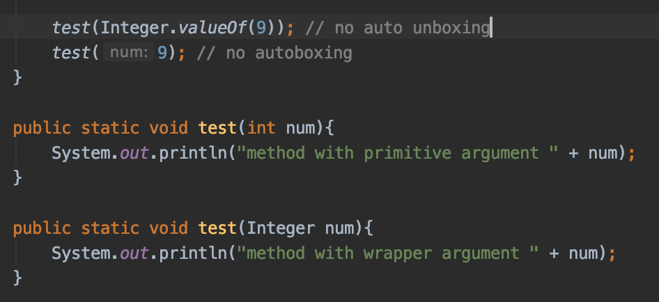
Autoboxing and Unboxing
Autoboxing and method overloading
No autoboxing or un-boxing are performed
E.g.

Slide 24
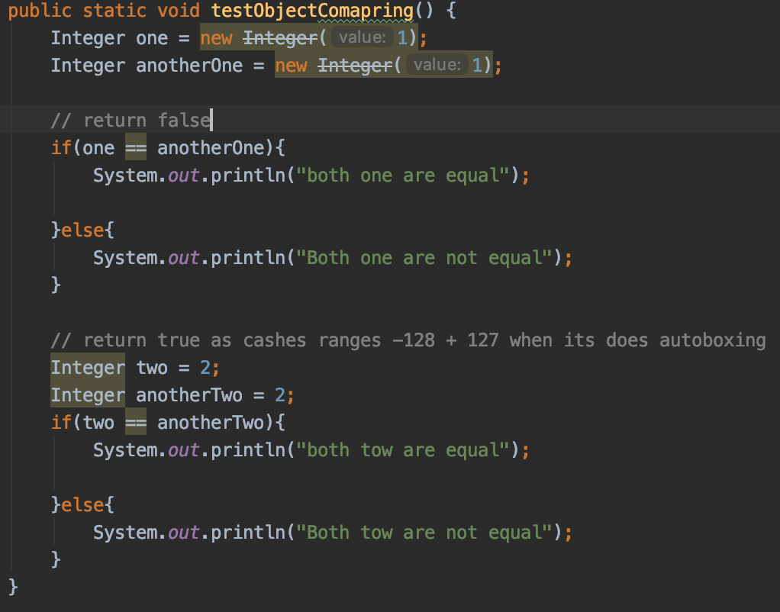
Autoboxing and Unboxing
When comparing Objects crated via new operator NO autoboxing or unboxing is performed. Object references are being compared, but when uses autoboxing then there is caching mechanism of ranges from -128 to 127

Slide 25
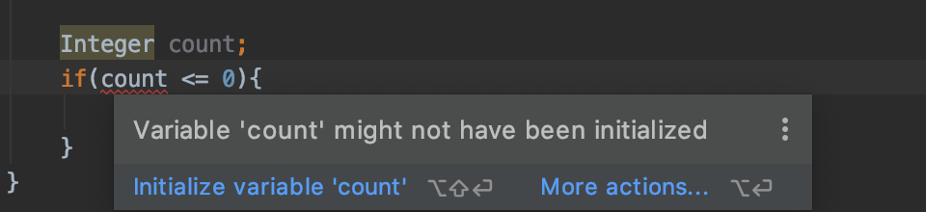
Autoboxing and Unboxing
Don’t forget to init your instances – no autoboxing to 0 is performed in next example

Slide 26
Welcome to programing with java course
We begin at 10:00 A.M.

Slide 27
Facts about the quiz
Array’s size is not changeable – it is fixed
Knowledge of correct declaration of arrays – one, two dimensional especially
Knowledge of how to access elements of arrays and looks after using of index out of array’s size
Arrays are very commonly used with for loops in tests

Slide 28
Facts about the quiz
Remember the correct syntax for arrays creation
Syntax | Example
Data_type[] refToArray = new Data_type[arraySize]; | Integer[] months = new Integer[12];
Data_type[] refToArray = {value0, value1, ..., valuek}; | Integer[] months = {1, 2, 3, 4, 5, 6 , 7, 8, 9, 10, 11, 12};
Data_type[] refToArray = new DataType[] {value0, value1, …}; | short [] args = new short[]{50, 50};
Data_type [] refToArray = … | short [] args = new short[4];
Data_type refToArra [] | short args [] = new short[5];

Slide 29
Questions?
Notes:
Do you have any questions?

Slide 30
Thank You For Your Time

